Slide 1

CASE STUDY ON RAPE VICTIMS
2016 & 2018

Slide 2
Questions For Analysis
Total details of 2016 and 2018
State wise Number Of victims 2016 and 2018
States with victims greater than 2000 from total of 2016 and 2018
Category wise comparison
State wise comparison
Age wise comparison

Slide 3
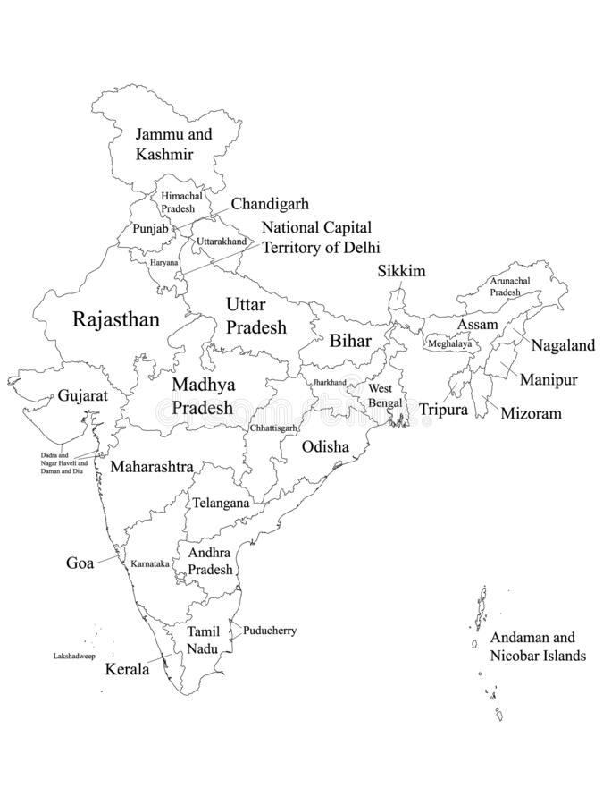
INDIA
29 STATES
&
7 UNION TERRITORIES

Slide 4
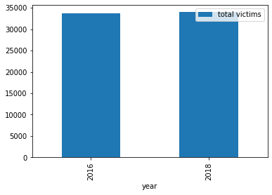
Graph representation of total Victims 2016 And 2018

Slide 5
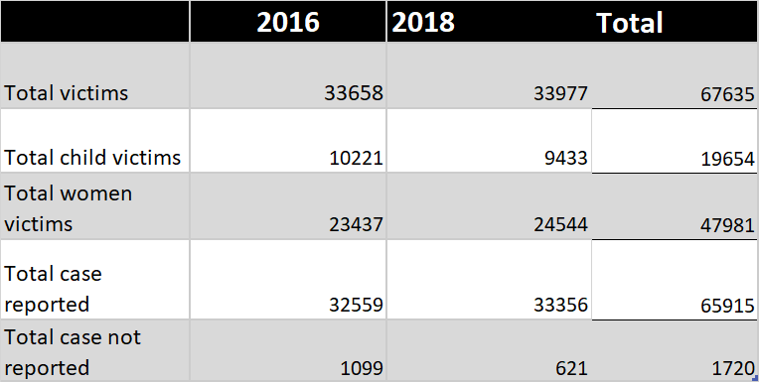
VICTIMS DETAILS OF 2016 & 2018

Slide 6
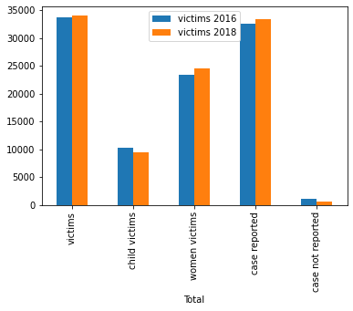
CATEGORISED REPORT OF
2016 AND 2018

Slide 7
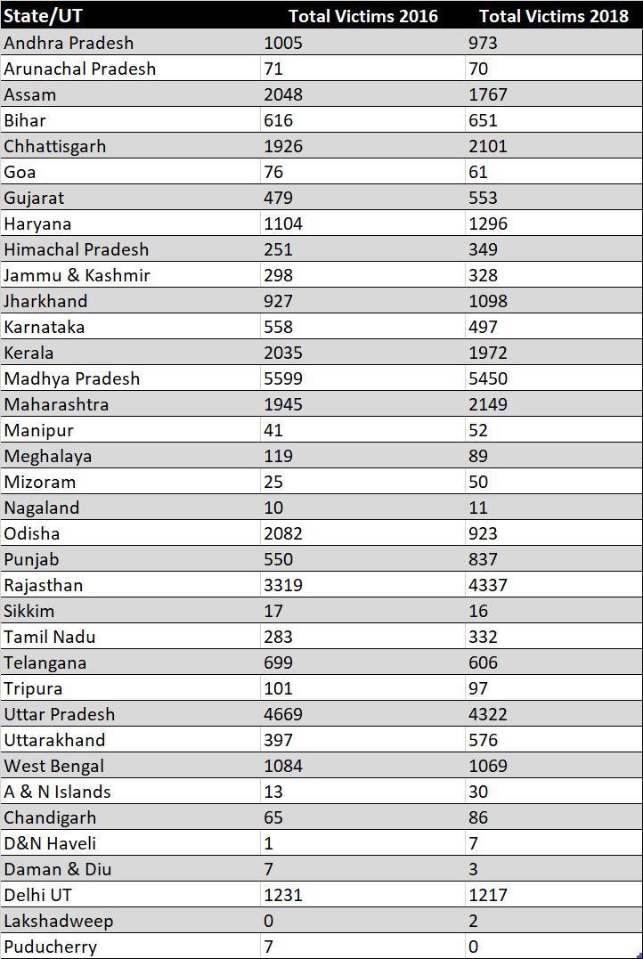
State wise Number Of Victims 2016 and 2018

Slide 8
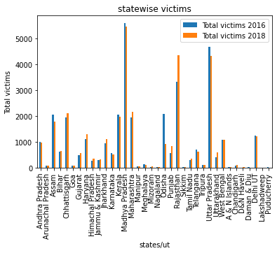
Graphical Representation of State wise Victims 2016 and 2018

Slide 9
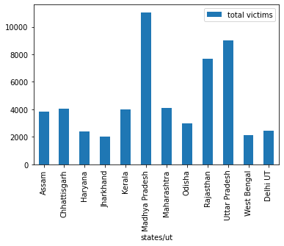
States with victims greater than 2000 from total of 2016 and 2018

Slide 10
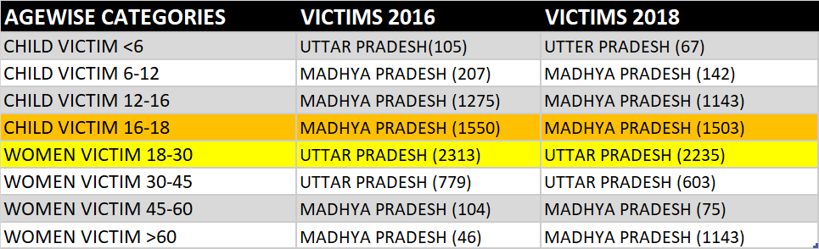
State wise comparison based on age

Slide 11
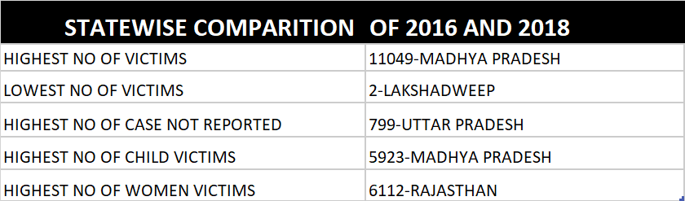
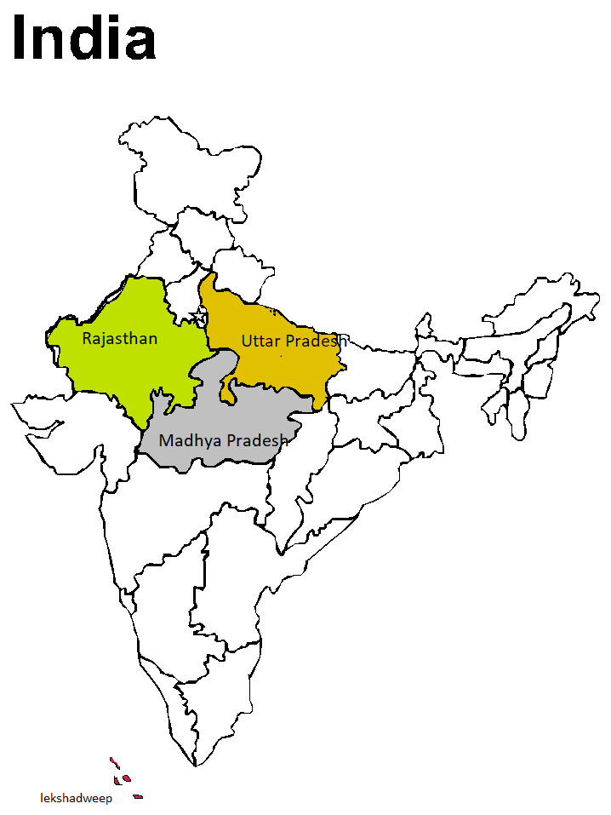

Slide 12
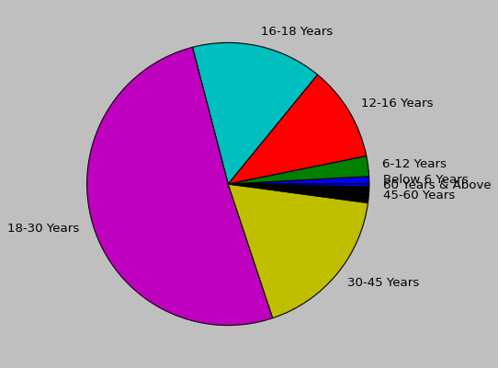
AGEWISE CATEGORIZED DATA
2016 AND 2018

Slide 13

SUMMARY
Even if there are lots of laws for women in India as we see in the reports the rape cases are increasing year by year.
Most women victims are in the age between the years of 18 to 30 and child victims of years 16-18.
As we see in the reports the state with highest no of victims are in Madhya Pradesh and lowest victims are in Lakshadweep.
Uttar Pradesh is the state which have maximum number of case not reported.
Going through the reports of India still 2020 there are Average 87 Rape Cases Daily.

Slide 14

THANK YOU
BY SHEFNA S

